Slide 1

Introduction to Computer Vision: Exploring How Machines Learn to See
This presentation explores the fascinating world of computer vision, where algorithms enable computers to interpret and understand visual information from the world around us. From basic image processing to advanced feature detection techniques, we'll examine the core concepts that allow machines to "see" and make sense of visual data.

Slide 2
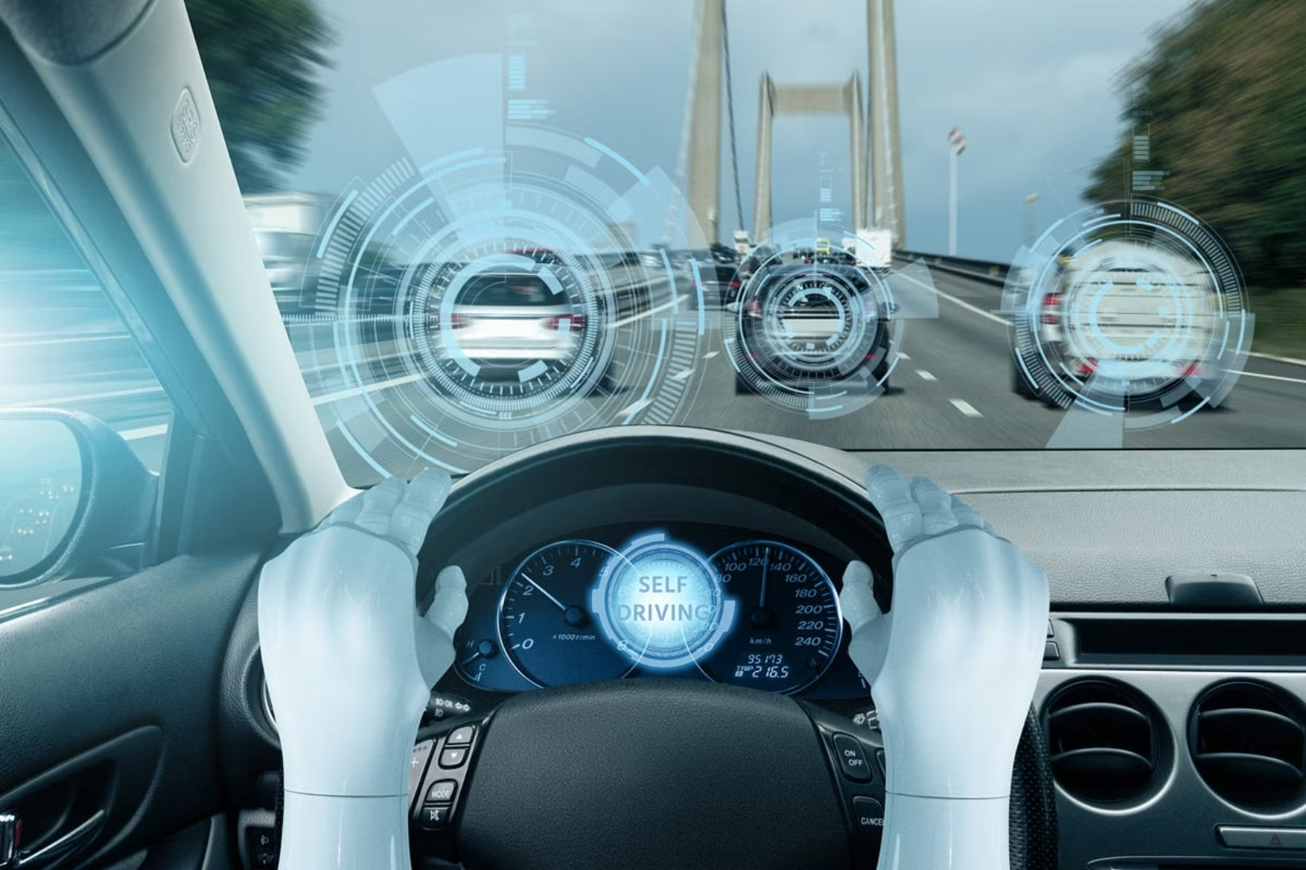
Why Computer Vision Matters
The Power of Visual Data
Computer vision transforms how machines interact with our visual world:
Humans process ~80% of information visually
Digital images/videos generate petabytes of untapped data daily
CV enables automation of visual tasks previously requiring human intelligence
Powers innovations from facial recognition to autonomous vehicles
Market projected to reach $48.6 billion by 2027

Slide 3




Applications Transforming Industries
Healthcare
Manufacturing
Medical image analysis for disease detection, surgical assistance, patient monitoring, and diagnostic support across radiology, pathology, and ophthalmology
Defect detection, quality control, inventory management, and robotic guidance systems that increase production efficiency and reduce errors
Transportation
Retail
Autonomous vehicles, traffic monitoring, license plate recognition, and driver assistance systems that enhance safety and efficiency
Cashierless stores, inventory tracking, customer behavior analysis, and personalized shopping experiences

Slide 4
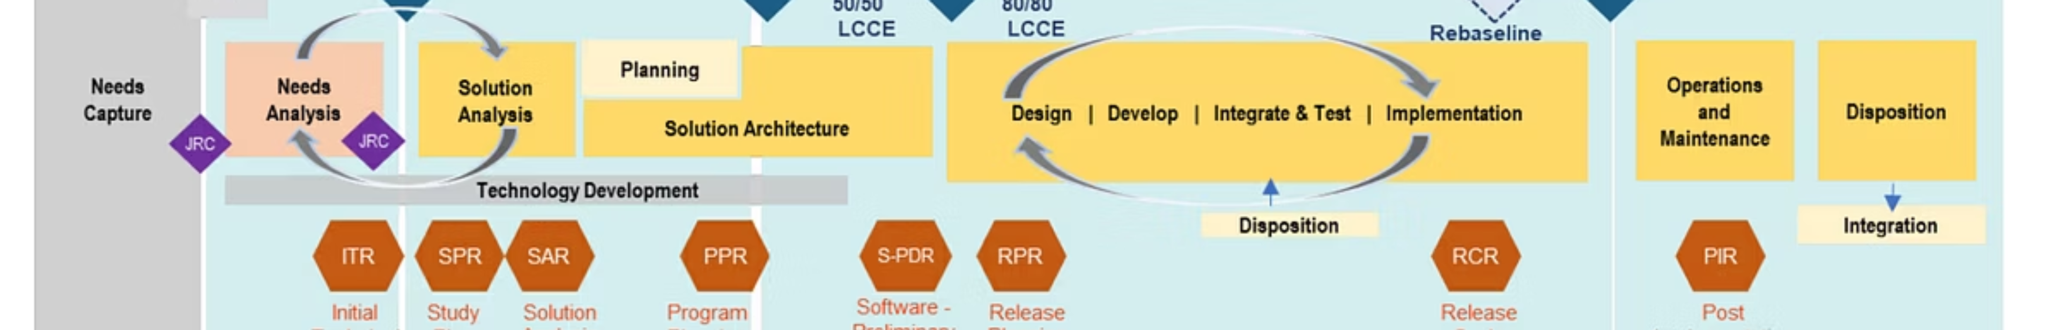




Computer Vision Pipeline
Image Acquisition
Pre-processing
Capturing visual data through cameras, sensors, or importing existing images
Enhancing images through filtering, normalization, and noise reduction
Feature Extraction
Decision Making
Identifying key points, edges, and descriptive elements
Classification, object detection, and semantic understanding

Slide 5

Image Processing: The Foundation
Image processing forms the backbone of computer vision by transforming raw pixel data into more useful forms for analysis:
Converts visual information into numerical data computers can process
Prepares images for feature extraction and recognition tasks
Enhances image quality and removes unwanted artifacts
Reduces dimensionality to focus on relevant information
Enables consistent interpretation despite varying lighting, angles, and noise

Slide 6
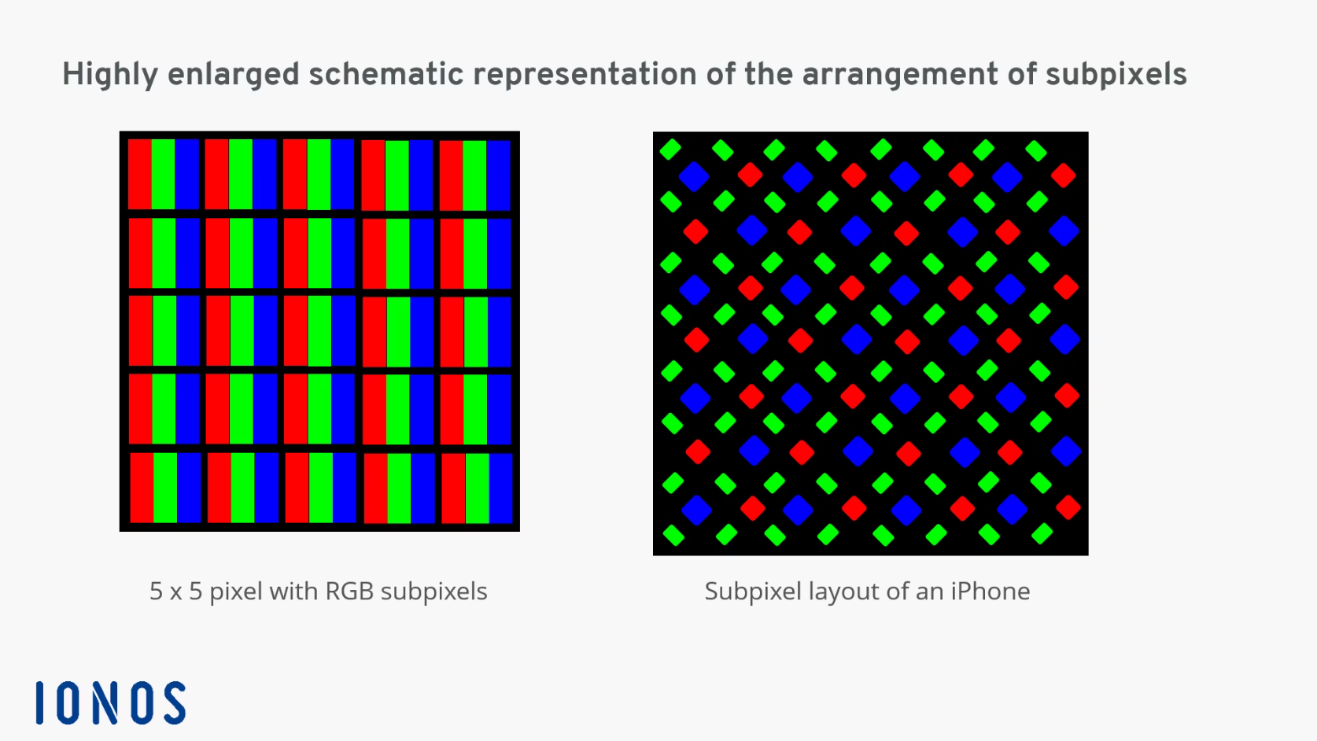
Reading & Displaying Images
Understanding Digital Images
Images are represented as multi-dimensional arrays of pixel values:
Grayscale: 2D array with intensity values (0-255)
Color: 3D array with channels (typically RGB)
Alpha channel: Optional 4th dimension for transparency
Common libraries like OpenCV make image manipulation straightforward:
import cv2# Read an imageimg = cv2.imread('image.jpg')# Display the imagecv2.imshow('Image', img)cv2.waitKey(0)

Slide 7
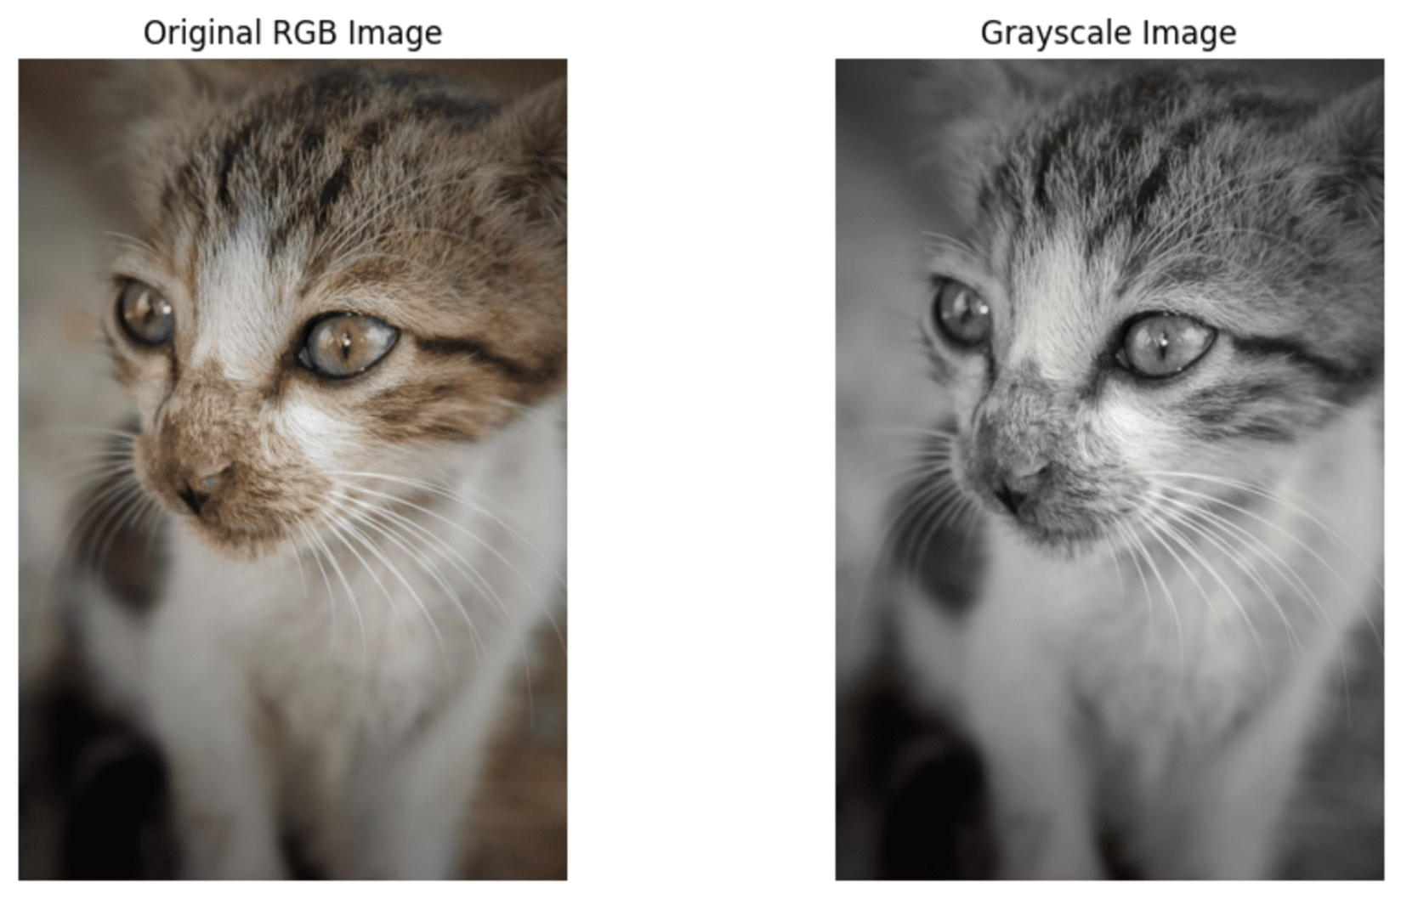
Grayscale Conversion: Simplifying Visual Data
Why Convert to Grayscale?
Reduces computational complexity (1 channel vs 3)
Simplifies algorithms for edge detection and thresholding
Preserves important structural information
Reduces sensitivity to color variations
Common Conversion Method:
# Convert to grayscalegray = cv2.cvtColor(img, cv2.COLOR_BGR2GRAY)
The weighted conversion typically uses: Y = 0.299R + 0.587G + 0.114B

Slide 8
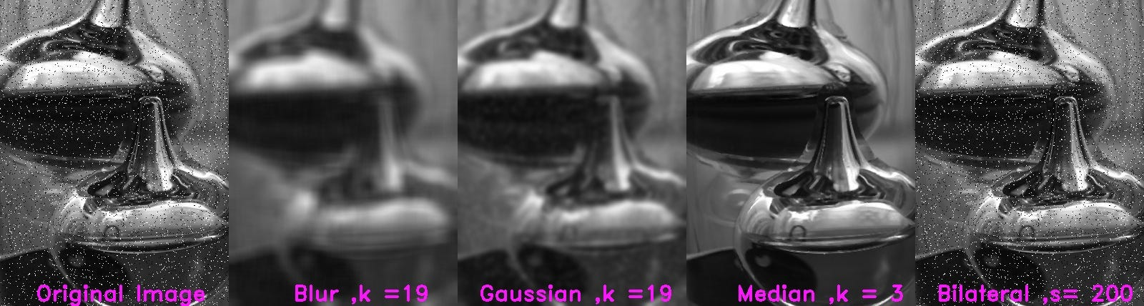
Blurring & Smoothing: Noise Reduction
Gaussian Blur
Median Blur
Bilateral Filter
Uses a Gaussian distribution to create weights for averaging. Effective for natural noise patterns and preserving edges better than simple averaging.
Replaces each pixel with the median of neighboring pixels. Excellent for salt-and-pepper noise while preserving edges.
Preserves edges while blurring by considering both spatial proximity and intensity differences.
median = cv2.medianBlur(img, 5)
bilateral = cv2.bilateralFilter(img, 9, 75, 75)
blur = cv2.GaussianBlur(img, (5,5), 0)

Slide 9
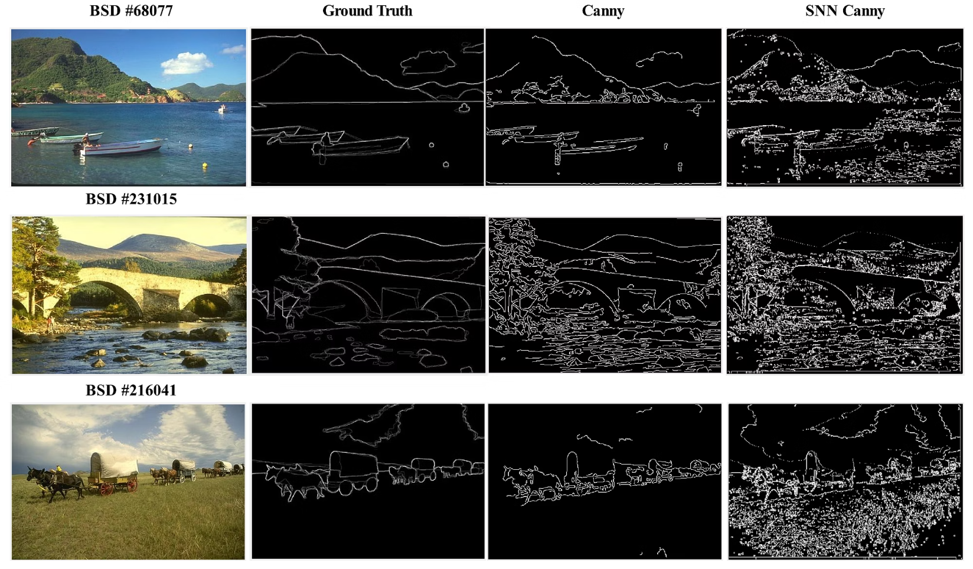
Edge Detection: Finding Boundaries
Edge detection identifies sudden changes in pixel intensity that often represent object boundaries—crucial for shape analysis and object recognition.
Common Operators:
Sobel: Emphasizes horizontal or vertical edges using gradient-based methods
Laplacian: Detects edges using a second derivative measure
Canny: Multi-stage algorithm with noise reduction, gradient calculation, non-maximum suppression, and hysteresis thresholding
# Canny edge detectionedges = cv2.Canny(gray, 100, 200)

Slide 10
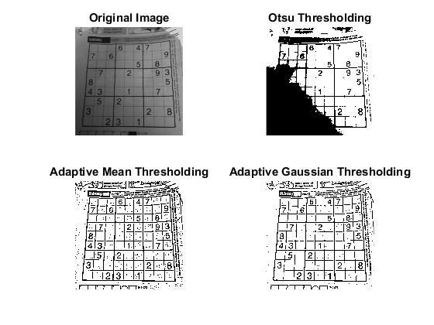
Thresholding: Binary Image Creation
Separating Foreground from Background
Thresholding converts grayscale images to binary by classifying pixels as either foreground or background based on intensity values.
Types of Thresholding:
Simple/Binary: Fixed threshold value (global)
Adaptive: Threshold varies across image regions
Otsu's: Automatically determines optimal threshold
# Simple thresholding
ret, thresh = cv2.threshold(gray, 127, 255, cv2.THRESH_BINARY)
# Adaptive thresholding
adaptive = cv2.adaptiveThreshold(gray, 255, cv2.ADAPTIVE_THRESH_GAUSSIAN_C, cv2.THRESH_BINARY, 11, 2)

Slide 11
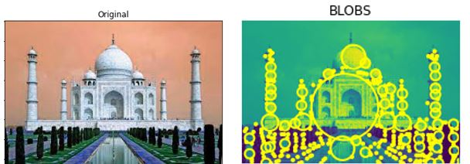
Feature Detection: Beyond Pixels
Feature detection identifies distinctive points or regions that:
Remain stable under transformations
Good features are recognizable despite changes in scale, rotation, perspective, and lighting conditions
Are highly distinctive
Each feature should be uniquely identifiable from others in the same image
Form compact representations
Allow efficient storage and matching operations even for complex scenes
Enable higher-level vision tasks
Support object recognition, image stitching, 3D reconstruction, and motion tracking

Slide 12
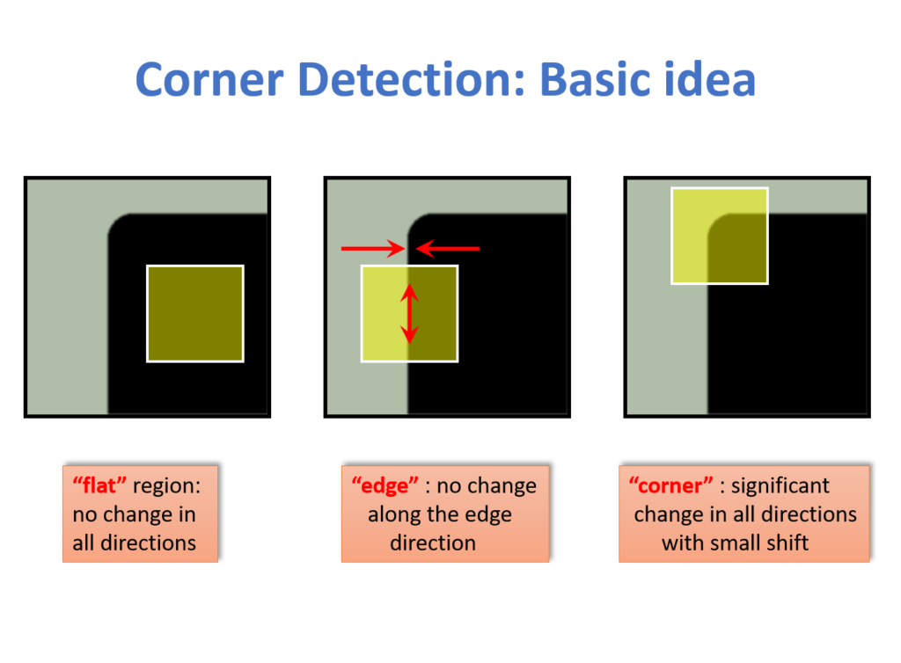
Harris Corner Detection
Finding Corners in Images
Harris corner detector identifies points where intensity changes in multiple directions simultaneously—typically corners.
How It Works:
Compute x and y derivatives of the image
Create the Harris matrix M for each pixel
Calculate corner response R using determinant and trace
Apply non-maximum suppression
Threshold to identify strong corners
# Harris corner detection
gray = cv2.cvtColor(img, cv2.COLOR_BGR2GRAY)
corners = cv2.cornerHarris(gray, 2, 3, 0.04)
Pros: Rotation invariant
Cons: Not scale invariant

Slide 13
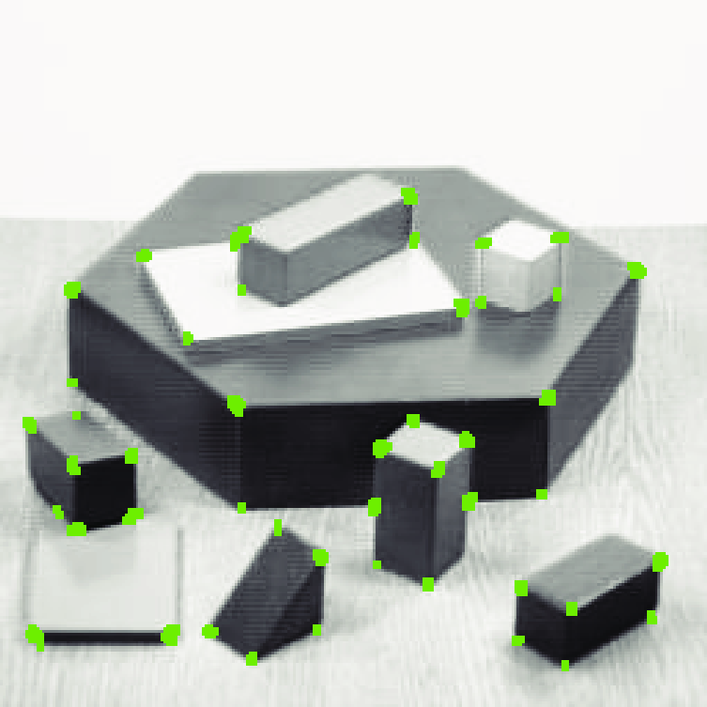
Shi-Tomasi Corner Detection
Good Features to Track
An improvement over Harris corner detection that's especially useful for tracking applications:
Modifies the Harris corner response calculation
Uses minimum eigenvalue rather than the Harris R function
Provides more stable and reliable corner detection
Returns exactly N strongest corners, sorted by quality
Ensures minimum distance between detected points
Widely used in optical flow and motion tracking
# Shi-Tomasi corner detection
corners = cv2.goodFeaturesToTrack(gray, maxCorners=25, qualityLevel=0.01, minDistance=10)

Slide 14
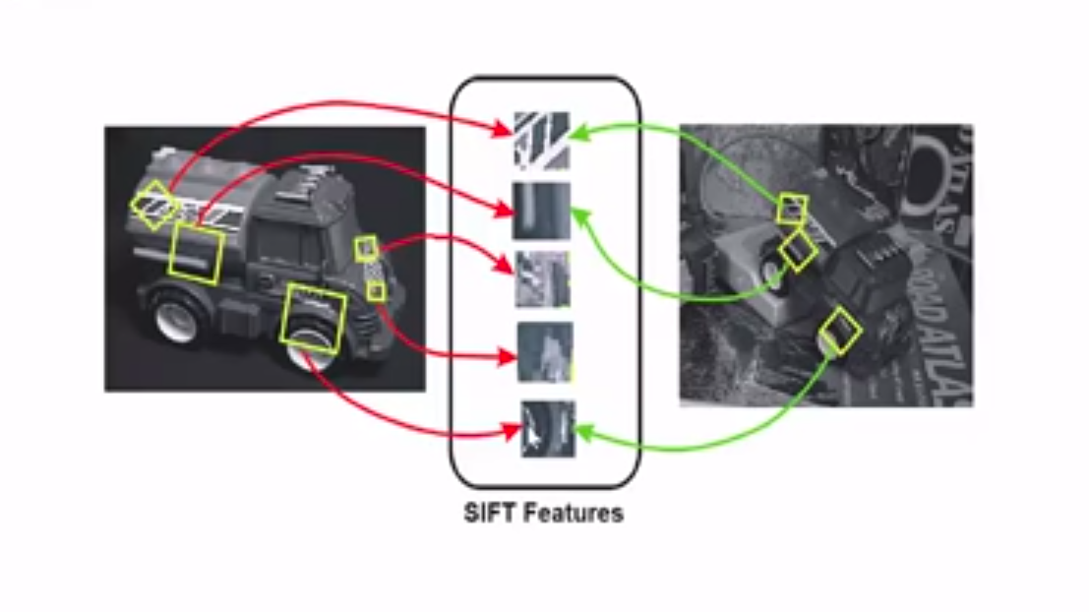
SIFT: Scale-Invariant Feature Transform
Scale Invariance
Rotation Invariance
Detects features across multiple scales using Difference of Gaussian (DoG) pyramid, making it robust to zooming and size changes
Assigns orientation to keypoints based on local gradient directions, enabling recognition regardless of rotation
Distinctive Descriptors
Creates 128-dimensional feature vectors using gradient histograms that uniquely identify keypoints
# SIFT implementation
sift = cv2.SIFT_create()
keypoints, descriptors = sift.detectAndCompute(gray, None)
Note: While SIFT offers excellent performance, it's patented technology. OpenCV moved it to the "contrib" modules, and some applications use alternatives like ORB for licensing reasons.

Slide 15
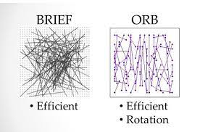
ORB: Oriented FAST and Rotated BRIEF
A Free Alternative to SIFT/SURF
ORB combines modified versions of FAST keypoint detector and BRIEF descriptor:
FAST: Finds keypoints by comparing pixel intensities in a circular pattern
Adds orientation computation using intensity centroid
BRIEF: Creates binary descriptor through intensity comparisons
Rotates BRIEF pattern according to keypoint orientation
Computationally efficient (much faster than SIFT)
Free to use commercially (no patents)
# ORB implementationorb = cv2.ORB_create()keypoints, descriptors = orb.detectAndCompute(gray, None)

Slide 16
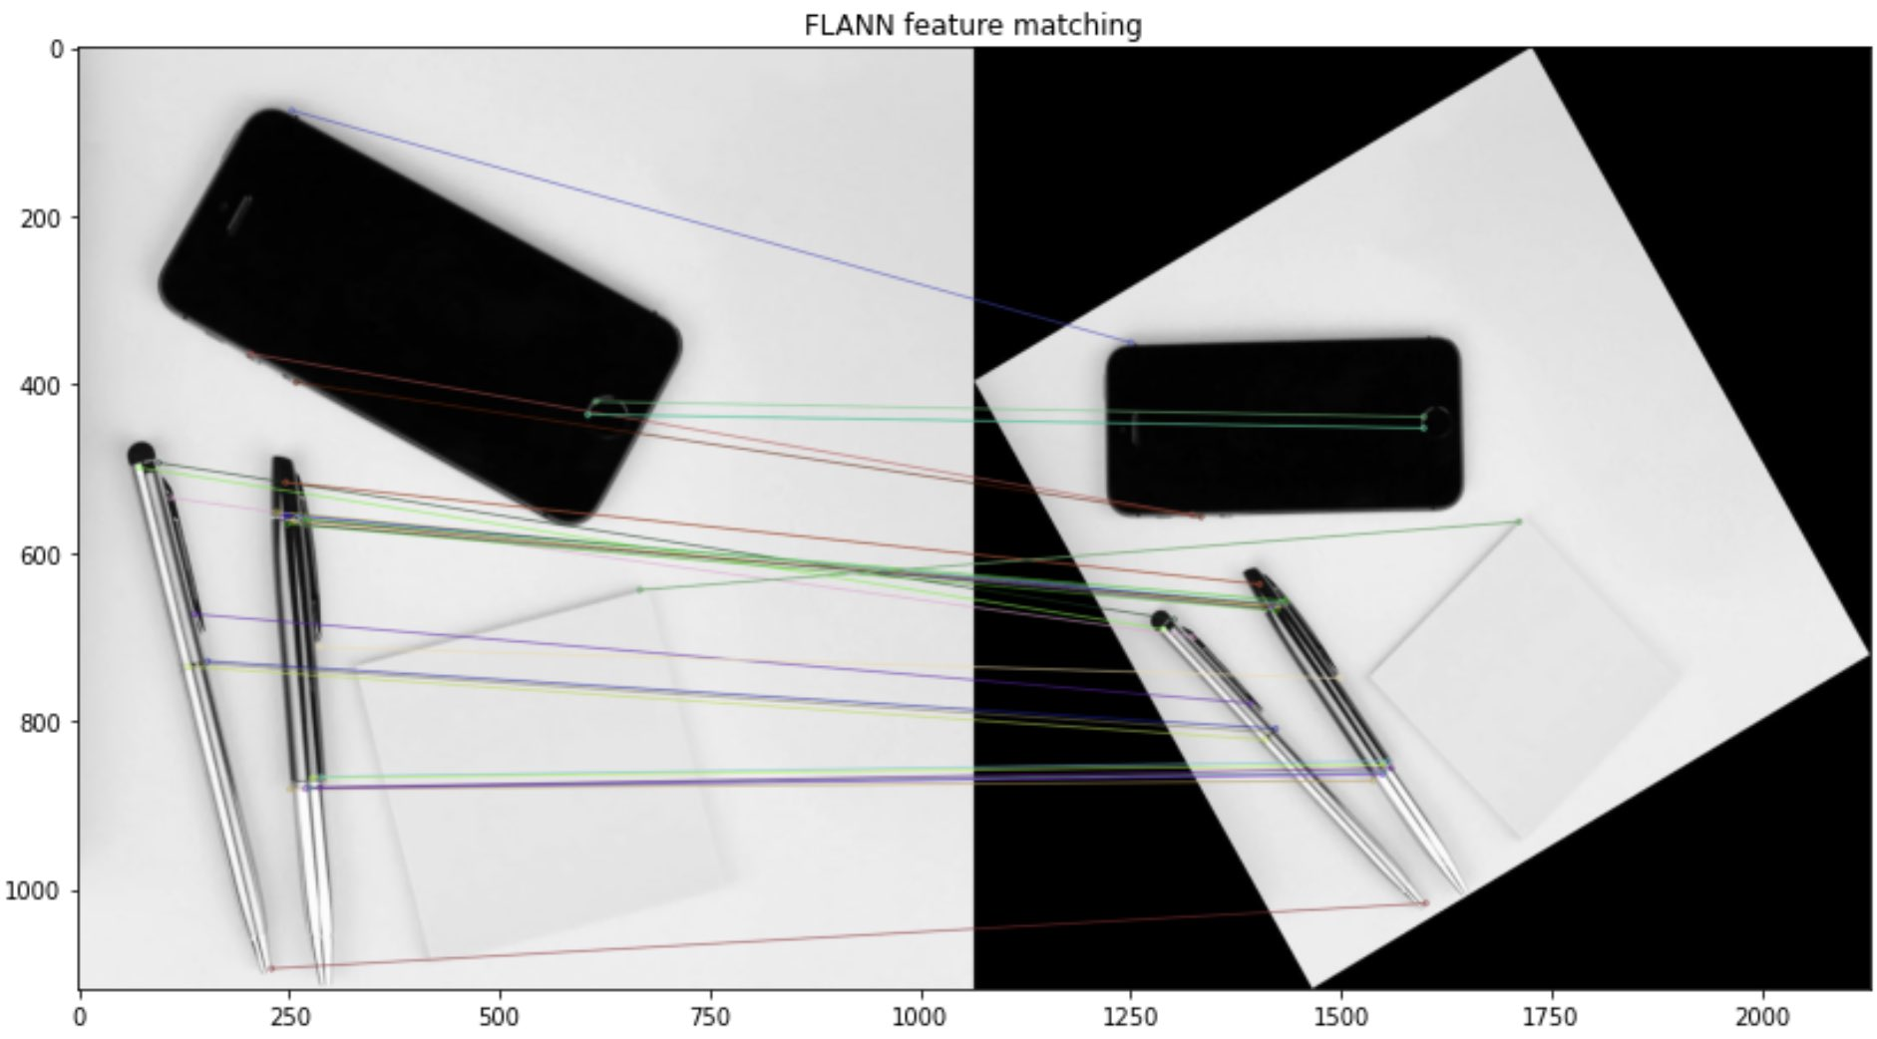
Feature Matching: Finding Correspondences
Connecting Features Across Images
Feature matching identifies corresponding points between images—essential for image stitching, object recognition, and 3D reconstruction.
Brute Force Matching
Compares each descriptor in first set with all descriptors in second set using distance measures (Euclidean, Hamming, etc.)
bf = cv2.BFMatcher()
matches = bf.knnMatch(desc1, desc2, k=2)
FLANN Matching
Fast Library for Approximate Nearest Neighbors provides faster matching for large datasets through optimized algorithms
flann = cv2.FlannBasedMatcher()
matches = flann.knnMatch(desc1, desc2, k=2)
Ratio test (Lowe's method) helps filter good matches by comparing distances between best and second-best matches

Slide 17
Challenges in Computer Vision
Viewpoint Variation
Illumination Conditions
Occlusion
Same object appears different when viewed from different angles
Changes in lighting dramatically affect pixel values
Objects may be partially hidden behind other objects
Scale Variations
Deformation
Background Clutter
Objects appear at different sizes depending on distance
Non-rigid objects change shape
Objects blend with similarly colored backgrounds
Intra-class Variation
Objects in same category can look very different

Slide 18


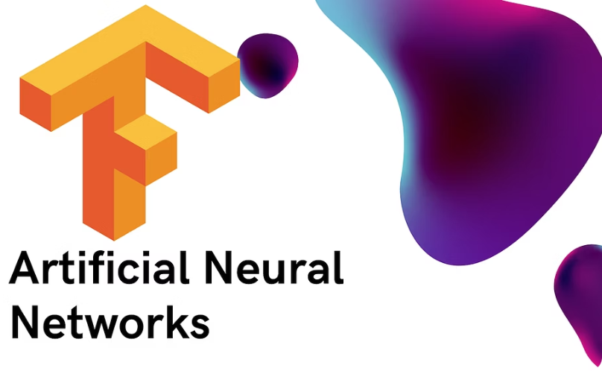

Computer Vision Libraries Ecosystem
OpenCV
PyTorch
TensorFlow
scikit-image
Open source library with 2500+ algorithms for classical CV and ML. Available in C++, Python, Java. Industry standard for traditional CV approaches.
Deep learning library with extensive support for computer vision through torchvision. Preferred in research for dynamic computation graphs.
Google's ML platform with TF-Vision and Object Detection API. Strong deployment options including mobile and edge devices.
Python library for image processing with focus on algorithm education. Simple API and excellent documentation for beginners.

Slide 19
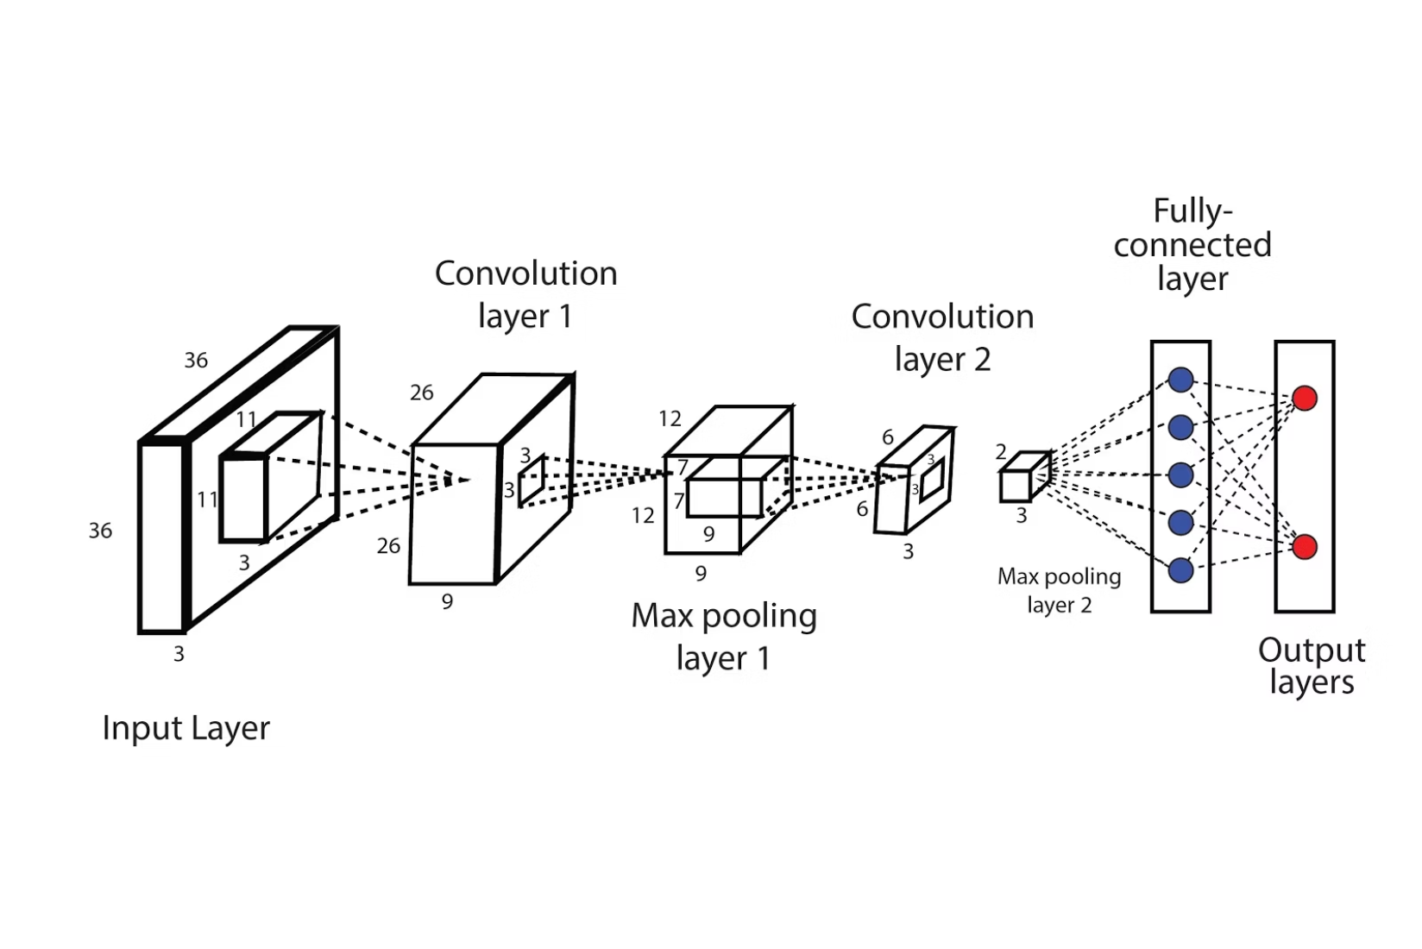
The Rise of Deep Learning in Computer Vision
Transforming the Field
Since 2012's AlexNet breakthrough, deep learning has revolutionized computer vision:
Convolutional Neural Networks (CNNs) automatically learn features from data
End-to-end training replaces hand-crafted feature engineering
Performance dramatically outpaces traditional approaches on benchmark tasks
New architectures like ResNet, Inception, and EfficientNet push accuracy boundaries
Transfer learning enables application with smaller datasets
While traditional CV techniques remain valuable for many applications, understanding deep learning is increasingly essential for computer vision engineers.

Slide 20
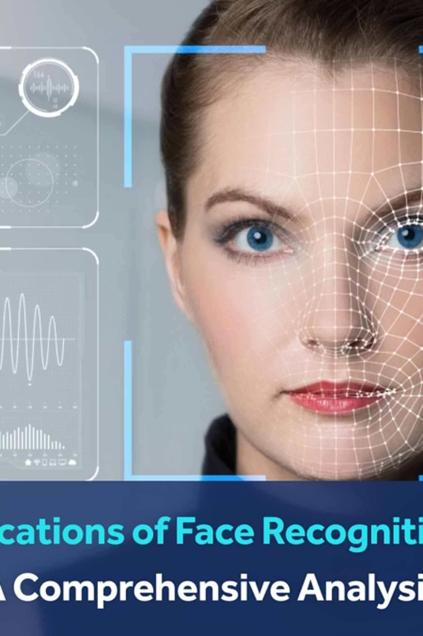
Computer Vision Ethics & Responsible Development
Critical Considerations for CV Engineers
Privacy Concerns
Face recognition, gait analysis, and behavior tracking raise significant privacy issues. Consider data minimization, opt-in consent, and anonymization techniques.
Bias & Fairness
CV systems trained on unrepresentative data show lower accuracy for underrepresented groups. Evaluate performance across demographic groups and mitigate bias through diverse training data.
Transparency
Users should understand when CV systems are in use and how decisions are made. Document limitations and provide explanations for critical applications.
Dual-Use Potential
Many CV technologies have both beneficial and harmful applications. Consider potential misuses during development and implement safeguards where possible.

Slide 21
Hands-On Project Ideas
1
2
Document Scanner
Face Filters
Build an app that detects document boundaries, applies perspective transform, and enhances readability. Teaches contour detection, perspective transformation, and thresholding.
Create Snapchat-like filters by detecting facial landmarks and overlaying graphics. Explores face detection, landmark identification, and image composition.
3
4
Object Counter
Gesture Control Interface
Develop a program that counts objects in images (e.g., cells in microscope images). Covers segmentation, contour analysis, and watershed algorithm.
Build a system that recognizes hand gestures to control applications. Teaches hand detection, contour analysis, and convex hull techniques.
These projects can be completed using OpenCV and Python with relatively little code, making them excellent starting points for building your portfolio.

Slide 22






Future Trends in Computer Vision
Vision Transformers
Few-Shot Learning
Moving beyond CNNs, transformer architectures are achieving state-of-the-art results by modeling long-range dependencies in images
Systems that can learn from very few examples, making CV more accessible for domains with limited labeled data
Multimodal Understanding
Edge AI
Combining vision with language, audio, and other modalities for more holistic scene understanding
Deployment of sophisticated CV models directly on edge devices with privacy preservation and reduced latency
Neuro-symbolic Approaches
Self-supervised Learning
Hybrid systems combining neural networks with symbolic reasoning for better interpretability
Training on unlabeled data by creating clever pretext tasks, reducing dependence on human annotation

Slide 23
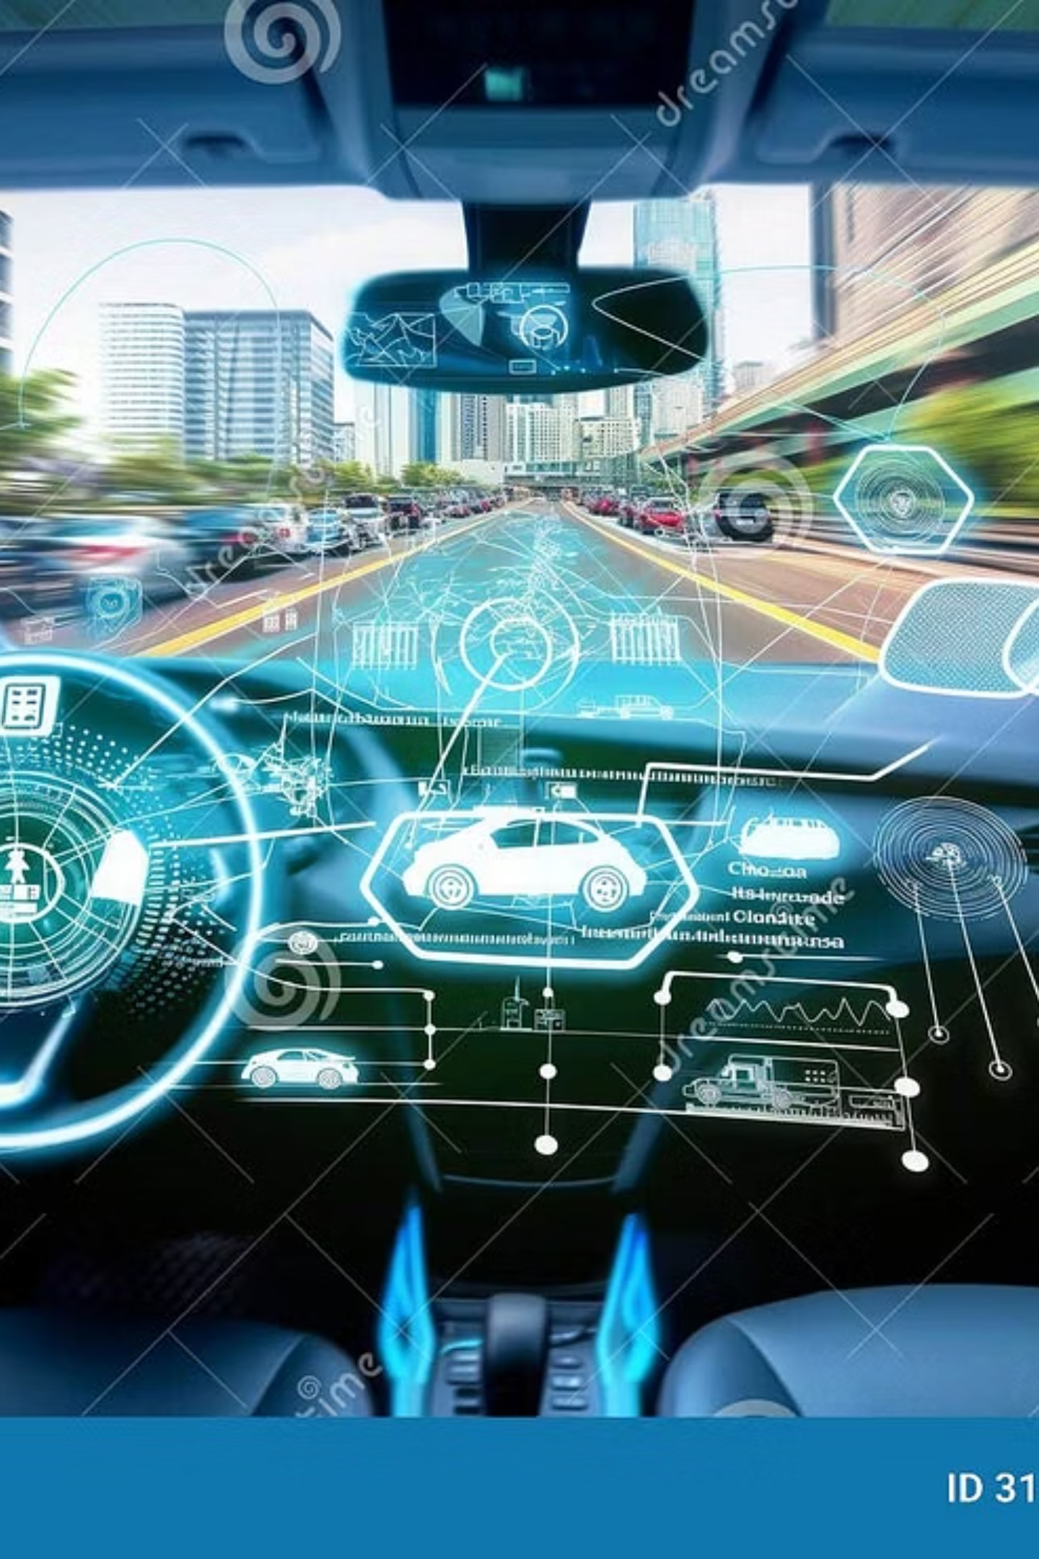


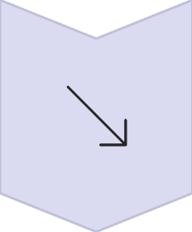

Real-World Application: Autonomous Vehicles
Computer Vision as the "Eyes" of Self-Driving Cars
Perception
Multiple cameras, LiDAR, and radar detect objects, lanes, traffic signs, and pedestrians
Scene Understanding
Semantic segmentation classifies each pixel into categories (road, vehicle, pedestrian, etc.)
Prediction
Systems predict future movements of detected objects to anticipate behavior
Planning
Based on visual data, vehicles plan safe trajectories through the environment
CV challenges in autonomous driving include handling adverse weather, recognizing rare events, and ensuring redundancy for safety-critical operations.

